Slide 1
LANDFORMS
Ms. Sinclair’s Saturday Science

Slide 5
Mountains
Do you know what these are?
How did you know?
What are some similar characteristics?
Some different characteristics?
Mt. Everest

Slide 8
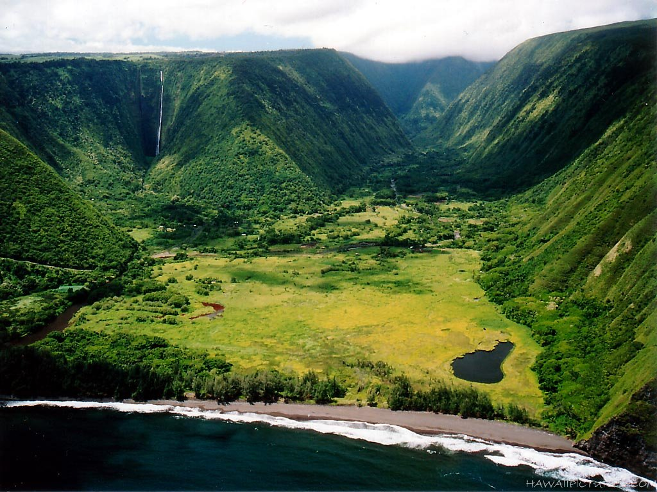

Slide 9
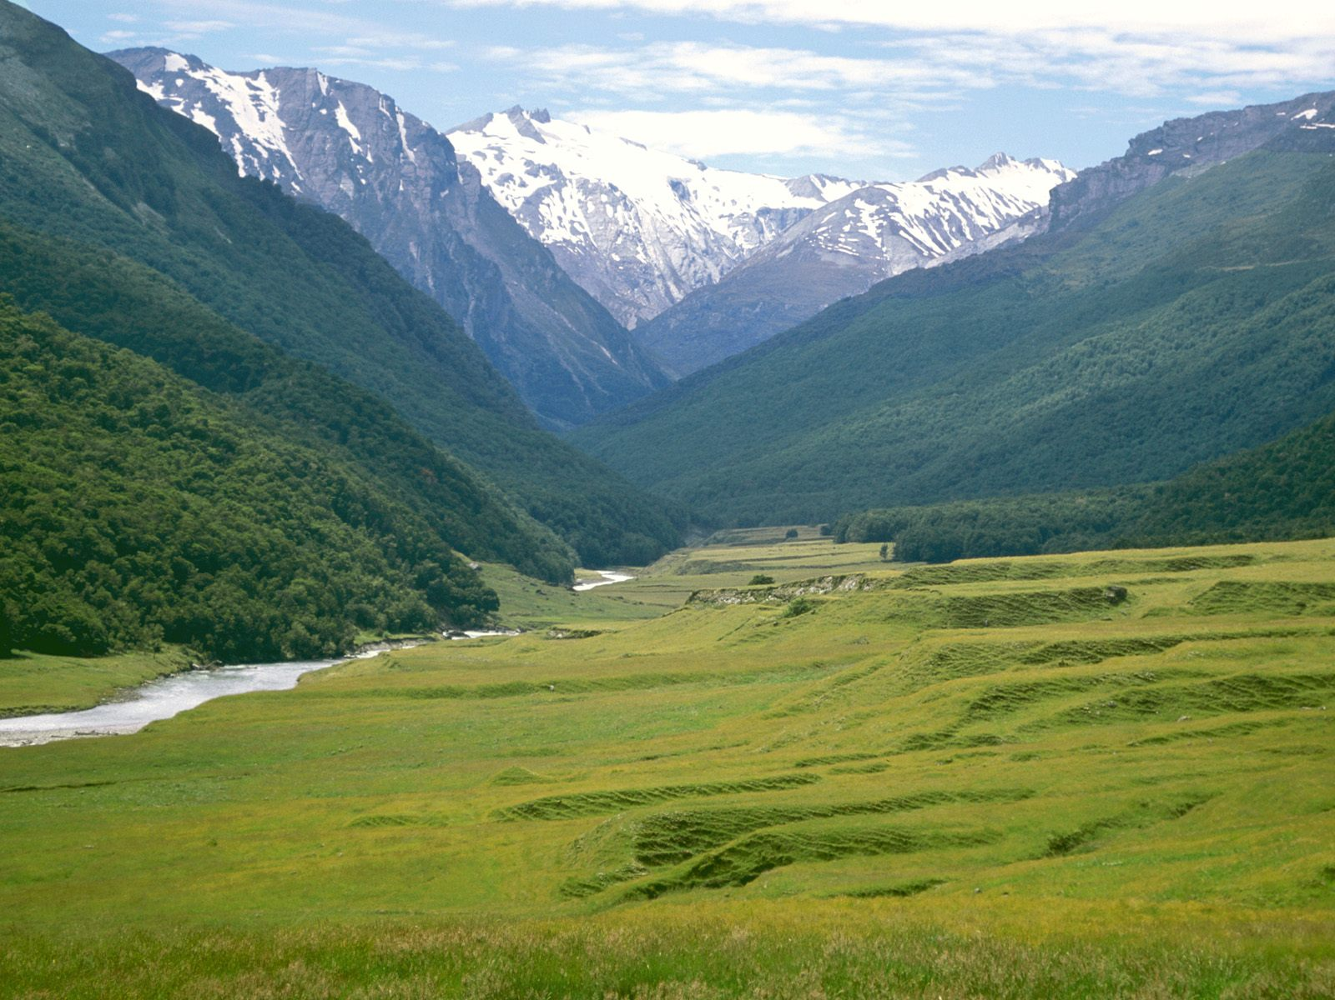
Valley
Do you know what these are?
How did you know?
What are some similar characteristics?
Some different characteristics?

Slide 10
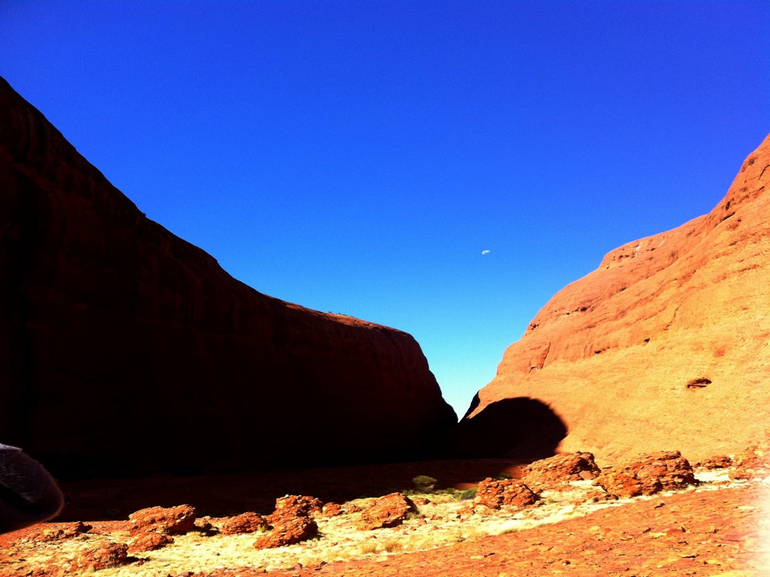
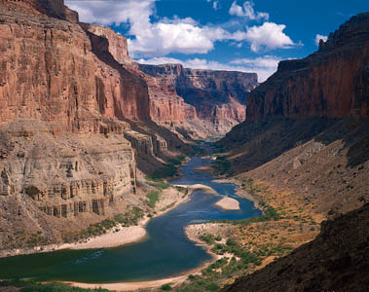
What’s the difference?

Slide 14
Desert
Do you know what these are?
How did you know?
What are some similar characteristics?
Some different characteristics?

Slide 18
River
Do you know what these are?
How did you know?
What are some similar characteristics?
Some different characteristics?

